Slide 1
Understanding the business value of systems and managing change
Laudon & Laudon
PowerPoint by Daniel Obuobi

Slide 2
Understanding the Business Value of Information Systems
Firms make two kinds of information systems investments.
  Firms invest in information systems projects that have very specific objectives and that will be implemented in 12 to 24 months.
  Firms also invest in information technology (IT) infrastructure, and such investments often take place over longer periods of time.
All information technology investments—both systems projects and infrastructure—produce value for firms primarily in two ways.
  The first is through improvement in business processes that increase firm efficiency.
  Second, information systems contribute to greater accuracy and speed of management decision making.

Slide 3
Business Value of IS
Information systems also create value by strengthening the firm strategically.
The value to the firm may not be an immediate superior return on investment, but instead a longer-term return on investment that results from a better strategic position in the industry.
Systems may help a firm achieve differentiable and sustainable advantages by, for instance, strengthening ties to customers and suppliers, differentiating products and services, and increasing flexibility and adaptability over longer periods.
Also, systems have value but that the firm may not capture all or even some of the value.
Some or all of a system’s benefits may not go to the business, but instead go directly to the consumer in the form of lower prices or more reliable services and products.

Slide 4
Capital budgeting
Capital budgeting is the process of analyzing and selecting various proposals for capital expenditures.
Information systems are considered long-term capital investment projects.
Six methods that are often used to compare different projects are the cost-benefit ratio, the net present value, the accounting rate of return on investment (ROI), the payback method, the internal rate of return (IRR), and the profitability index. [Figure 15-1 Figure 15-2]

Slide 5
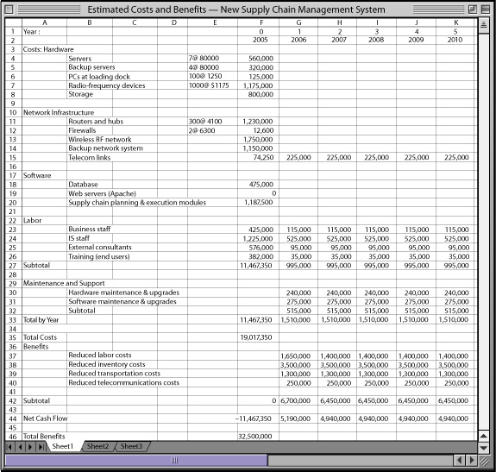
supply chain management system
FIGURE 15-1 Costs and benefits of the new supply chain management system
This spreadsheet analyzes the basic costs and benefits of implementing supply chain management system enhancements for a midsized midwestern U.S. retailer.
The costs for hardware, telecommunications, software, services, and personnel are analyzed over a six-year period.

Slide 6
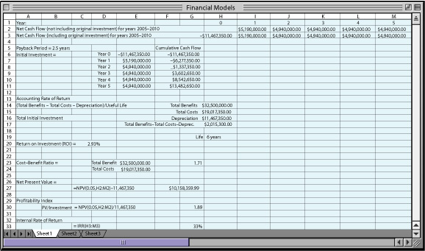
Financial models
FIGURE 15-2 Financial models
To determine the financial basis for a project, a series of financial models helps determine the return on invested capital. These calculations include the payback period, the accounting rate of return on investment (ROI), the cost-benefit ratio, the net present value, the profitability index, and the internal rate of return (IRR).

Slide 7
Tangible & intangible benefits
The cost-benefit ratio is the ratio of benefits to costs.
The tangible benefits of information systems can be quantified and assigned a monetary value.
Intangible benefits, such as more efficient customer service or enhanced decision making, cannot be immediately quantified but may lead to quantifiable gains in the long run.
The net present value is the amount of money an investment is worth, taking into account its cost, earnings, and the time value of money.

Slide 8
rate of return on investment
The accounting rate of return on investment (ROI) calculates the rate of return from an investment by adjusting cash inflows produced by the investment for depreciation. It gives an approximation of the accounting income earned by the project. The net benefit is divided by the total initial investment to arrive at the rate of return (ROI).

Slide 9
Internal rate of return (IRR)
The internal rate of return (IRR) is the rate of return or profit that an investment is expected to return. IRR is the discount (interest) rate that will equate the present value of the project’s future cash flows to the initial cost of the project.
The payback method measures the amount of time required to pay back the initial investment of a project. It is calculated by dividing the amount of the original investment by the annual net cash inflow generated by the investment.
The profitability index is used to compare the profitability of alternative investments. It is calculated by dividing the present value of the total cash inflow from an investment by the initial cost of the investment.

Slide 10
Financial models and Costs/benefits
Financial models are based on the premise that all relevant alternatives have been examined, that all costs and benefits are known, and that these costs can be expressed in money.
Financial models must be used with caution. Costs and benefits do not occur in the same time frame.
Costs tend to be up front and tangible, while benefits tend to be back-loaded and intangible.
Portfolio analysis is used to select alternatives after strategic analyses have determined the overall direction of systems development. Portfolio analysis is an analysis of the portfolio of potential applications within a firm to determine the risks and benefits and select among alternatives for information systems. [Figure 15-3]

Slide 11
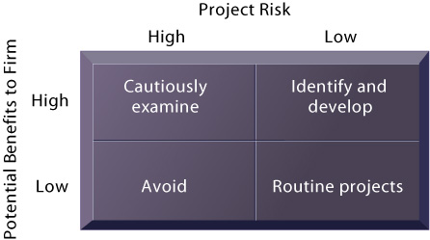
A system portfolio
FIGURE 15-3 A system portfolio
Companies should examine their portfolio of projects in terms of potential benefits and likely risks. Certain kinds of projects should be avoided altogether and others developed rapidly. There is no ideal mix. Companies in different industries have different profiles.

Slide 12
scoring model
A scoring model is a quick method of deciding among alternative systems based on a system of ratings for selected objectives.
Scoring models give alternative systems a single score based on the extent to which they meet the selected objectives.

Slide 13
Real options pricing models (ROPMs)
Real options pricing models (ROPMs), which apply the same techniques for valuating financial options to systems investments, are useful for evaluating highly uncertain information system investments.

Slide 14
real options theory
In real options theory, the value of the IT project (real option) is a function of
  the value of the underlying IT asset (present value of expected revenues from the IT project),
  the volatility of the value in the underlying asset,
  the cost of converting the option investment into the underlying asset,
  the interest rate at which the company could invest the same amount of money as the investment without any risk, and
  the options time to maturity (length of time the project can be deferred).

Slide 15
Disadvantages of real options theory
The disadvantages of this model are primarily in estimating all the key variables, especially the expected cash flows from the underlying asset, and changes in the cost of implementation.

Slide 16
Value of Knowledge
A different approach to traditional capital budgeting involves focusing on the knowledge input into a business process as a way of determining the costs and benefits of changes in business processes from new information systems.
The value of the knowledge used to produce improved outputs of the new process can be used as a measure of the value added. Knowledge inputs can be measured in terms of learning time to master a new process, and a return on knowledge can be estimated.

Slide 17
investment in information technology
Heavy investment in information technology has not automatically produced productivity gains.
Productivity changes among information workers are difficult to measure because there is no agreement on what constitutes an appropriate unit of output for information work.
Computers may increase the quality of products, and services or create new products, and such intangibles are also not addressed by traditional measures of productivity.

Slide 18
investment in information technology
However, a series of recent studies has found that information technology investments have resulted in increased productivity and better financial performance, including higher stock valuations, especially when accompanied by complementary organizational investments.
Information technology investments are more likely to improve firm performance if they were accompanied by complementary investments in new business processes, organizational structures, and organizational learning that could unleash the potential of the new technology.

Slide 19
The Importance of Change Management in Information System Success and Failure
A high percentage of large information systems are considered failures.
An information system failure is a system that either does not perform as expected, is not operational at a specified time, or cannot be used in the way it was intended.
These failures can be traced to four basic information system problems: design, data, cost, and operations. [Figure 15-4]

Slide 20
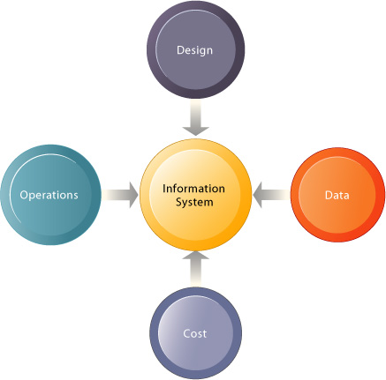
Information systems problem areas
FIGURE 15-4 Information systems problem areas.
Problems with an information system’s design, data, cost, or operations can be evidence of a system failure

Slide 21
design
The design of the system may fail to capture essential business requirements or a user interface may be excessively complicated or confusing.
Data may have a high level of inaccuracy, or incompleteness, or may not be broken out for optimum use.
Some information systems that operate smoothly may be considered failures because they are too costly to implement or operate.
Systems are failures when information is not provided in a timely and efficient manner because the computer operations that handle information processing may break down.

Slide 22
additional challenges
There are additional challenges to implementing global information systems.
Deeply rooted cultural, political, and language differences have led to different telecommunications standards, levels of service, and levels of skills and technical expertise.
Consequently, most companies attempting to create global forms of organization have had trouble building well-functioning global systems where information flows seamlessly among different operating units in different parts of the world.

Slide 23
implementation
One can better understand the organizational factors responsible for system success and failure by examining different patterns of implementation.
Managerial and organizational factors, such as the role of users and management in the implementation process, the manner in which the project handles complexity and risk, and the quality of management of implementation projects have a profound effect on system failure or success.

Slide 24
implementation.
Especially important is the relationship between participants in the implementation process, notably the interactions between systems designers and end users.
In the context of implementation, the systems designer is a change agent who develops solutions and redefines work flows and relationships among various groups in the organization.

Slide 25
Change Agent
A successful change agent mediates between competing interest groups and ensures that organizational adjustment to changes is complete.
The success of organizational change depends on how well information systems specialists, end users, and decision makers deal with key issues at various stages in implementation.

Slide 26
behavioral and organizational issues
Four largely behavioral and organizational issues are factors in determining the outcome of a system’s implementation:
  (1) the role of users in the implementation process;
  (2) the degree of management support and commitment;
  (3) the level of complexity and risk of the project; and
  (4) the quality of management of the implementation process. [Figure 15-5]

Slide 27
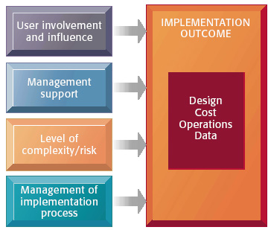
Information systems success or failure factors
FIGURE 15-5 Information systems success or failure factors
The implementation outcome can be largely determined by the role of users, the degree of management support, the level of risk and complexity of the implementation project, and the quality of management of the implementation process. Evidence of the information system’s success or failure can be found in the areas of design, cost, operations, and data.

Slide 28
user-designer communications gap
The technical orientation of system designers and the business orientation of end-users—a phenomenon known as the user-designer communications gap—must be resolved.
Management support and control of the implementation process are essential as are mechanisms for dealing with the level of risk in each new systems project.
User involvement in the systems-building process increases the chances of success because users have more opportunity to shape the system to meet their priorities and requirements and because they are more likely to support innovation when they have been actively involved in the change process.

Slide 29
Management of implementation
The conflicts and uncertainties inherent in the change process will be magnified if an implementation project is poorly managed and organized.
A systems-building project lacking good management is likely to suffer cost overruns that vastly exceed budget, poor technical performance, and delays in completion, failing to obtain anticipated benefits.
There are no proven techniques for estimating the length of time to build systems.
Very large-scale systems projects with ambitious programs for change suffer extraordinary rates of failure.

Slide 30
project risk
Researchers have identified three key dimensions that influence the level of project risk: project size, project structure, and experience with technology.
The larger the project—as indicated by dollars spent, the size of the implementation staff, the time allocated to implementation, and the number of organizational units affected—the greater the risk.
Projects that are more highly structured run a much lower risk than those whose requirements are relatively undefined, fluid, and constantly changing.

Slide 31
project risk
Users in highly structured projects tend to know exactly what they want and what the system should do.
The project risk will rise if the project team and the information system staff are unfamiliar with the hardware, system software, application software, or database management system proposed for the project.
Time completing the system will be lost if the system-building team needs to master new skills.

Slide 32
Management of Implementation process
A systems development project without proper management will most likely suffer these consequences: costs that vastly exceed budgets, unexpected time slippage, technical shortfalls resulting in performance significantly below the estimated level, and failure to obtain anticipated benefits.
Some possible reasons for the poor management of projects include ignorance and optimism about the time required to analyze and design systems; failures in reporting slippage and failure to upper management; and the use of the man-month to estimate costs and labor needed.
The man-month is based on the premise that the addition of labor to a project reduces time to completion.
However, many tasks in systems development are sequentially linked and cannot be reduced in labor or time by adding more workers. [Figure 15-6]

Slide 33

Consequences of poor project management
FIGURE 15-6 Consequences of poor project management
Without proper management, a systems development project takes longer to complete and most often exceeds the allocated budget. The resulting information system most likely is technically inferior and may not be able to demonstrate any benefits to the organization.

Slide 34
Why information systems fail
Many information systems fail because of the difficulties of managing the organizational change associated with a new information system.
For example, the primary reason why 70% of business process reengineering and enterprise system projects fail is because of inadequate change management.
Customer relationship management and supply chain management systems are also difficult to implement successfully because they also involve many organizational change issues.
Mergers and acquisitions do not always deliver benefits because of the organizational as well as the technical difficulties of integrating the information systems of the combining companies.

Slide 35
Managing Implementation
Projects using a complex new technology are riskier and require internal integration tools to ensure that the implementation team is a cohesive unit.
Highly structured projects with no technical challenges can benefit from the use of formal planning and control tools project management techniques, such as Program Evaluation and Review Technique or Gannt charts, to define tasks, budget resources, and monitor progress toward task completion. [Figure 15-7]

Slide 36
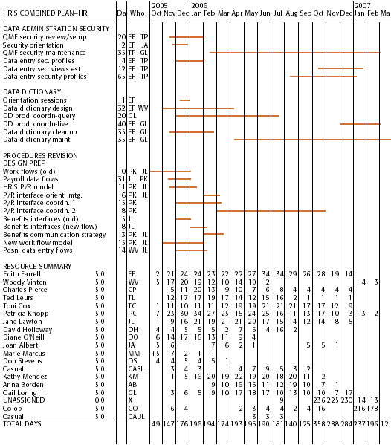
Formal planning and control tools
FIGURE 15-7 Formal planning and control tools help to manage information systems projects successfully
The Gantt chart in this figure was produced by a commercially available project management software package.
It shows the task, person-days, and initials of each responsible person, as well as the start and finish dates for each task.
The resource summary provides a good manager with the total person-days for each month and for each person working on the project to manage the project successfully.
The project described here is a data administration project.

Slide 37
counterimplementation.
Projects lacking structure require external integration tools to involve users at all stages.
Users can become leaders or active members of the system--building team or they can take charge of training, installation, and system assessment.
Implementation strategy should both encourage user participation and involvement and address the issue of counterimplementation.
Counter-implementation is a deliberate strategy to undermine the implementation of an information system.

Slide 38
organizational impact analysis
Systems analysis and design activities should include an organizational impact analysis that explains how a proposed system will affect organizational structure, attitudes, decision making, and operations.
Ergonomics--the interaction of people and machines in the work environment including such issues as design of jobs, health issues, and the information system end--user interface--must be considered.

Slide 39
sociotechnical design
A sociotechnical design approach emphasizes participation by the individuals most affected by the new system.
The design plan establishes human objectives for the system that lead to increased job satisfaction.
Designers set forth separate sets of technical and social design solutions.
The social design plans explore different work group structures, allocation of tasks, and the design of individual jobs.
The design solution that best fulfills both technical and social objectives is selected.

Slide 40
Cooptation tactics
Companies seeking to implement global systems should define a small subset of core business processes and focus on building core systems that can support these processes.
Cooptation tactics may be necessary to help ensure that widely dispersed foreign units participate in global systems building while global headquarters maintains overall control.

Slide 41
Management Opportunities, Challenges, and Solutions
By changing business processes and the culture of management decision making, new information systems produce extraordinarily high returns if system builders effectively manage the change process and accurately calculate the costs and benefits of their investments.
Management challenges in successful systems building includes determining system benefits and costs when they are difficult to quantify, and dealing with the complexity of large-scale systems projects.

Slide 42
Management Opportunities, Challenges, and Solutions
To meet these challenges, organizations need to find ways of measuring the business value of their information systems and ensuring that systems actually deliver the benefits they promise.
Firms can take a number of steps to obtain more benefits and returns from their systems investments.
They can start by fully documenting the firm’s applications and IT infrastructure and conducting periodic reviews of the firm’s IT portfolio.

Slide 43
Management Opportunities, Challenges, and Solutions
Project risks and returns should be clearly identified.
Real options analysis should be conducted to identify projects that will enable future opportunities.
Managers should be measuring business value throughout the duration of new system projects and should not hesitate to weed out underperforming projects if necessary.

Slide 44
Management Opportunities, Challenges, and Solutions
Firms can also invest in new approaches to project management that are more suitable to enterprise wide development.
Project and subproject managers should focus on solving problems and meeting challenges as they arise rather than simply meeting formal project milestones.
New project management techniques emphasize learning as well as planning, seeking ways to adapt to unforeseen uncertainties and chaos that, if properly handled, could provide additional opportunities and benefits

Slide 45
End of Chapter 15
Chapter 16 next

